Slide 1
Molecular approaches in medical research and diagnostics MOM521 (3 credits)
SAM

Slide 2
Disclaimer
The images and the content of this presentation are not my creative piece of work. They were created by others and assembled by me to make up the content of this course.

Slide 3
Use the link below to answer some few questions.
https://protect-za.mimecast.com/s/TX3dC2Rq5Wippz6rGCnPgA8

Slide 4
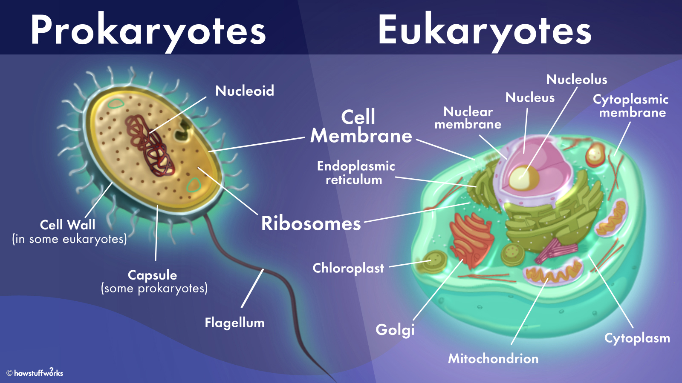

Slide 5
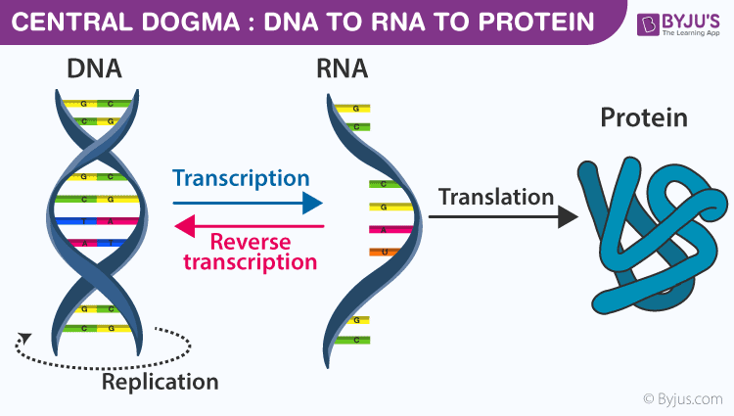

Slide 6
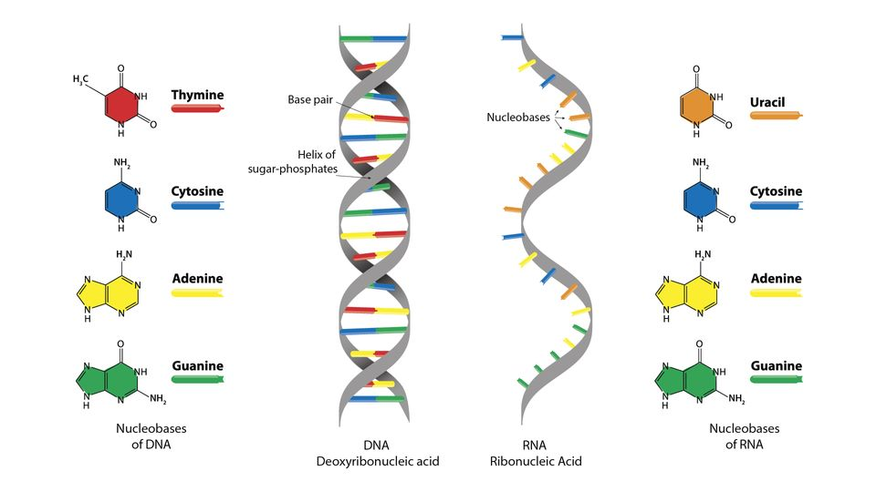
Differences between DNA and RNA

Slide 7
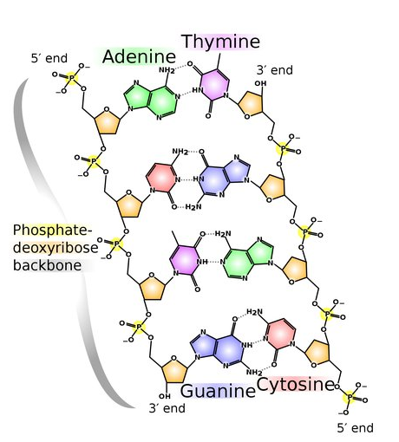
DNA Building Blocks

Slide 8
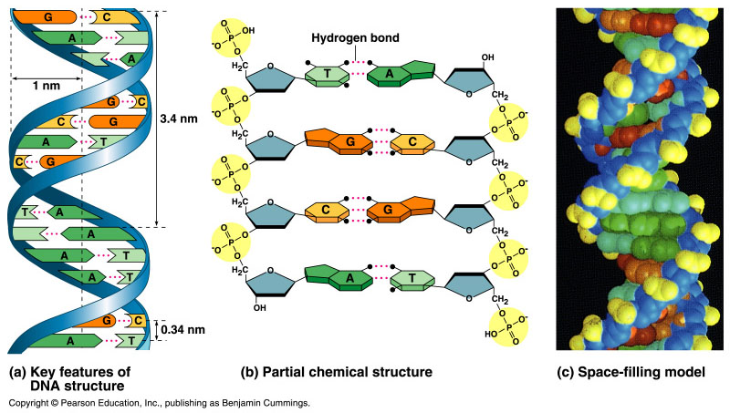
Bonding in DNA
hydrogen
bonds
5′
3′
covalent
phosphodiester
bonds
3′
5′

Slide 9
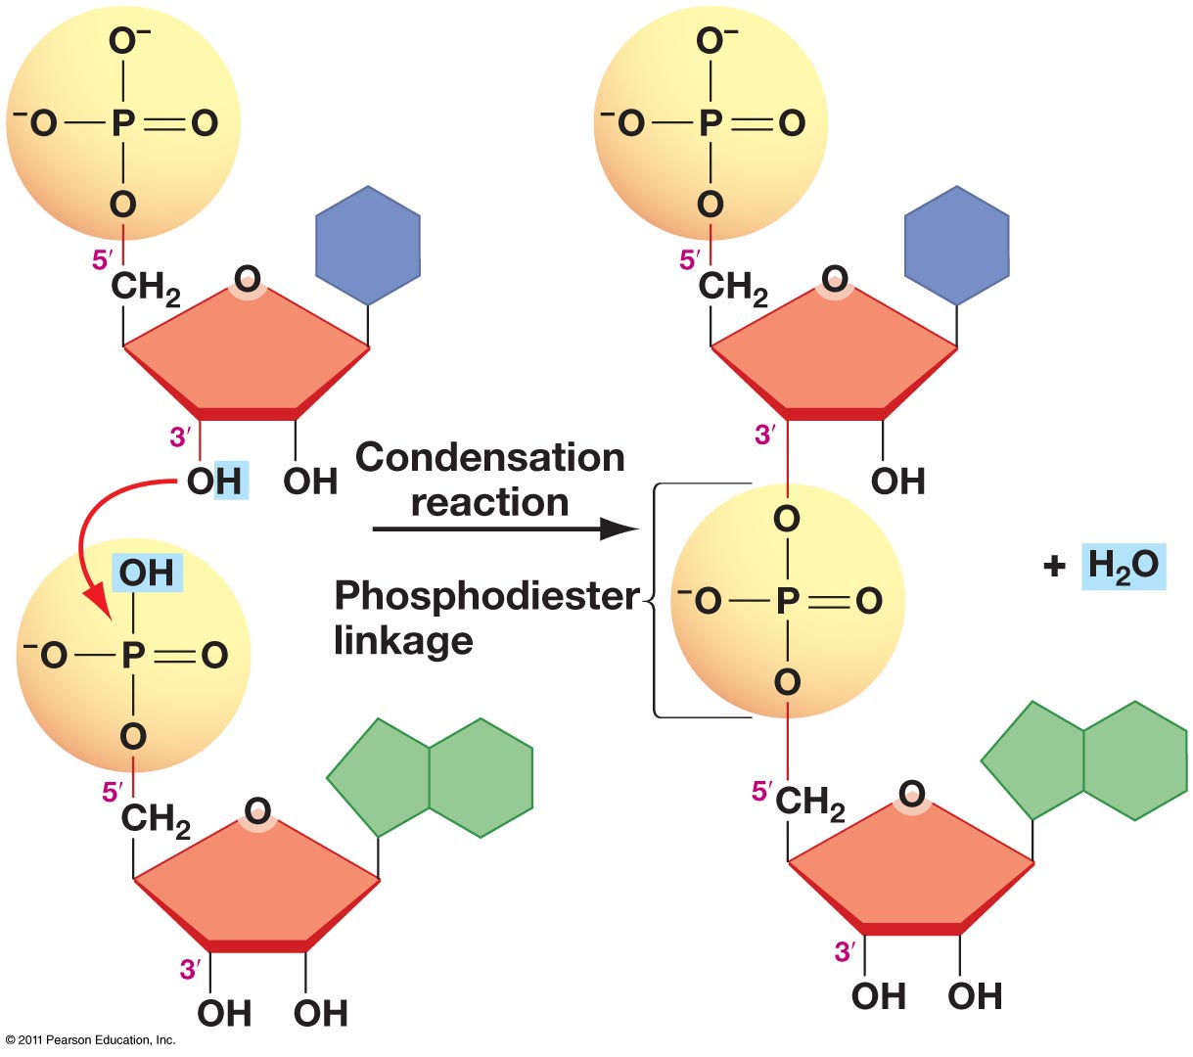
Formation of covalent phosphodiester bonds

Slide 10

Replication

Slide 11
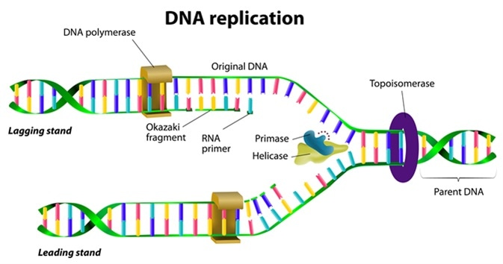

Slide 12

Transcription

Slide 13
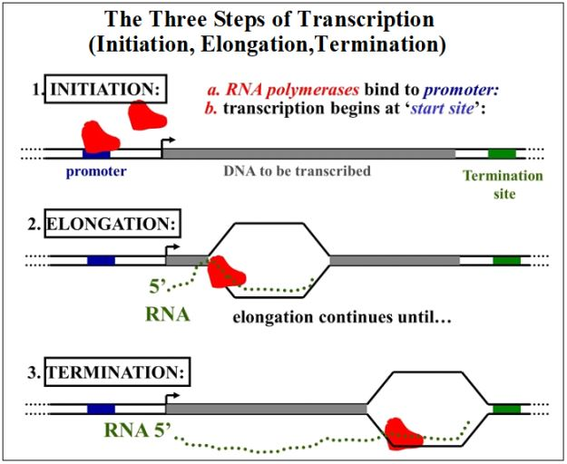
Transcription

Slide 14
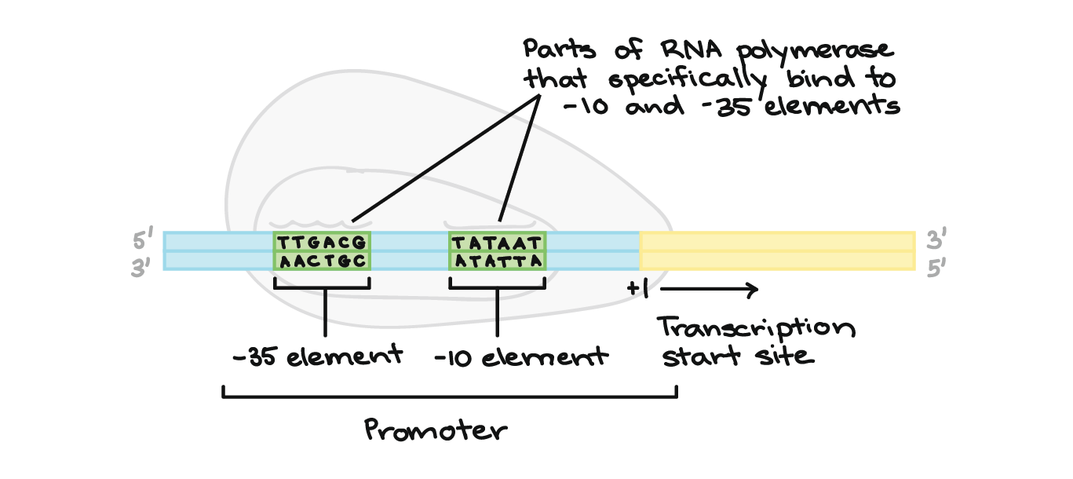
Transcription start site

Slide 15
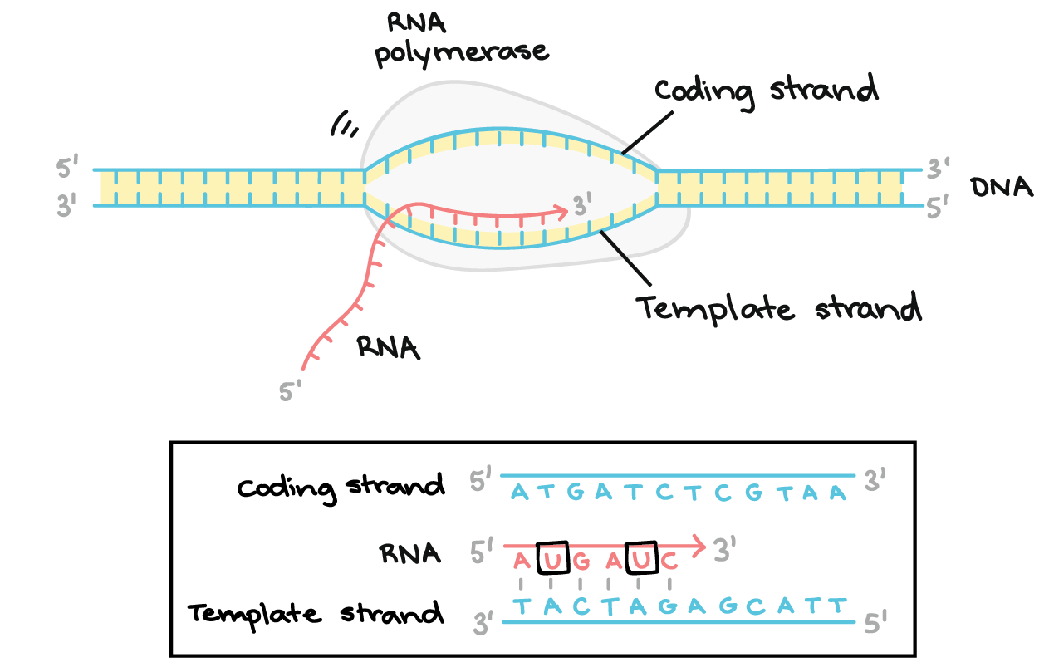
Transcription elongation

Slide 16
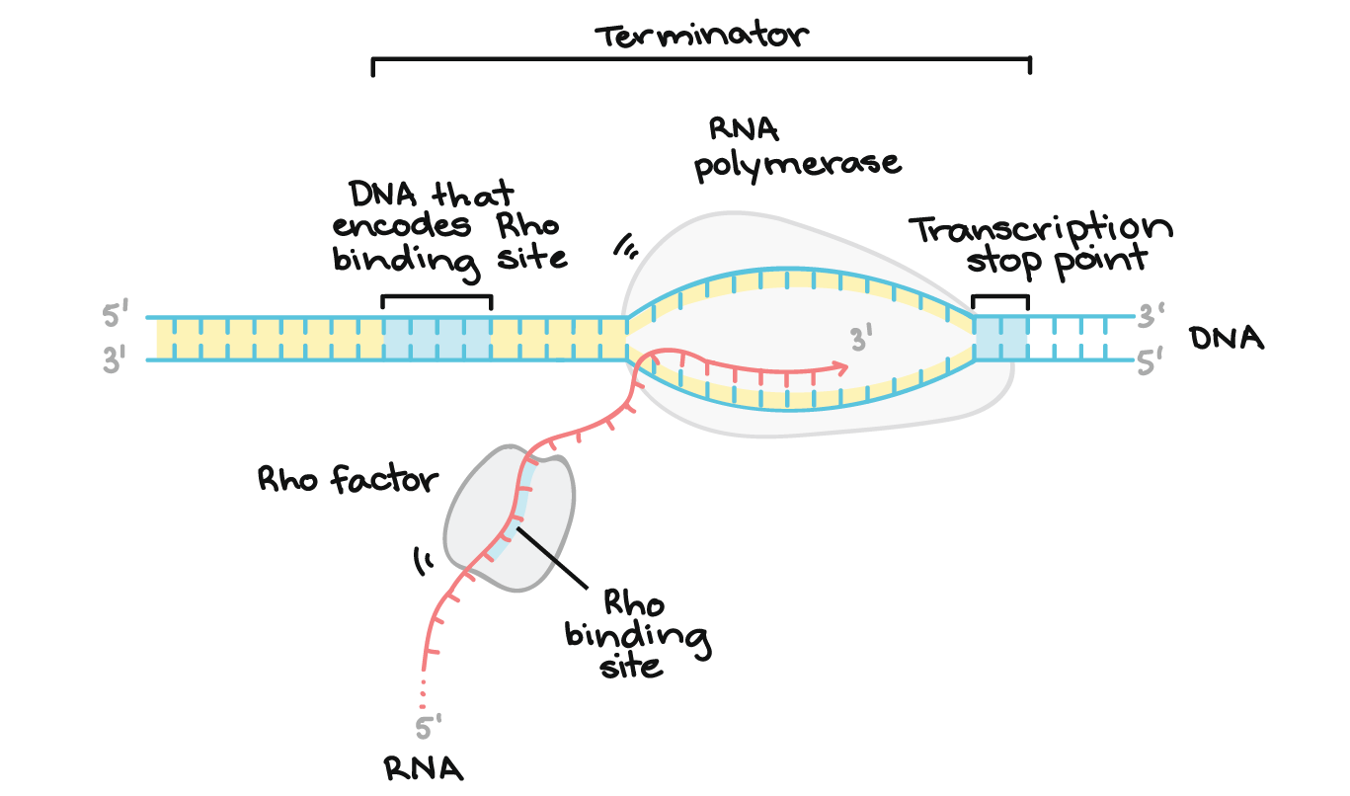
Transcription termination

Slide 17

Translation

Slide 18
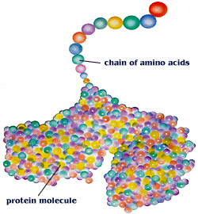
Decoding of mRNA into a protein is called Translation
Proteins are composed of amino acids – there are 20 different amino acids
Different proteins are made by combining these 20 amino acids in different combinations

Slide 19
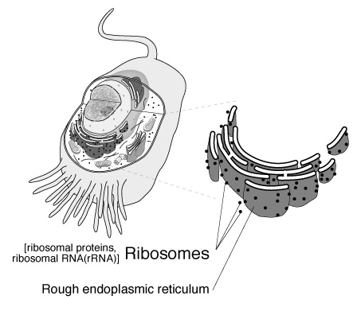
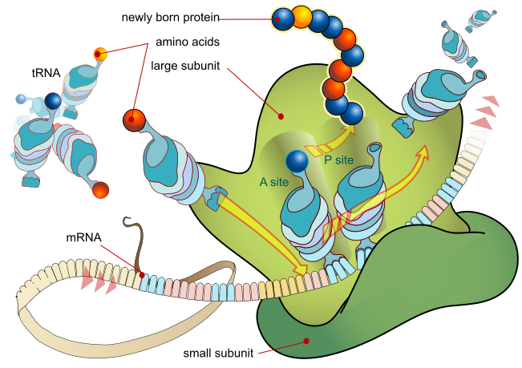
Proteins are manufactured (made) by the ribosomes

Slide 20
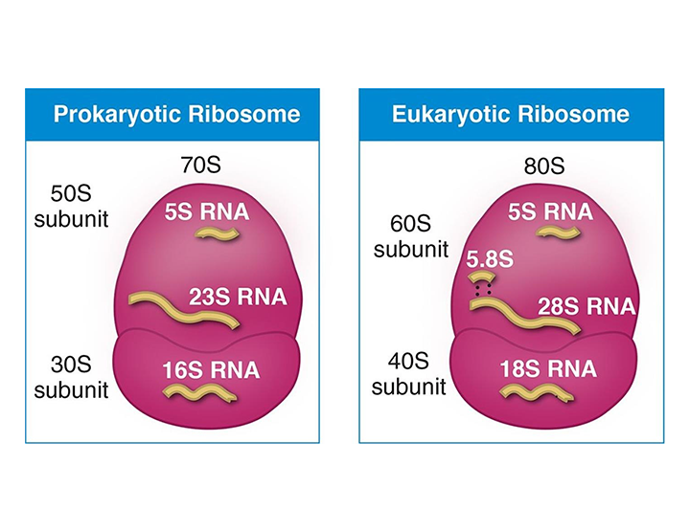

Slide 21
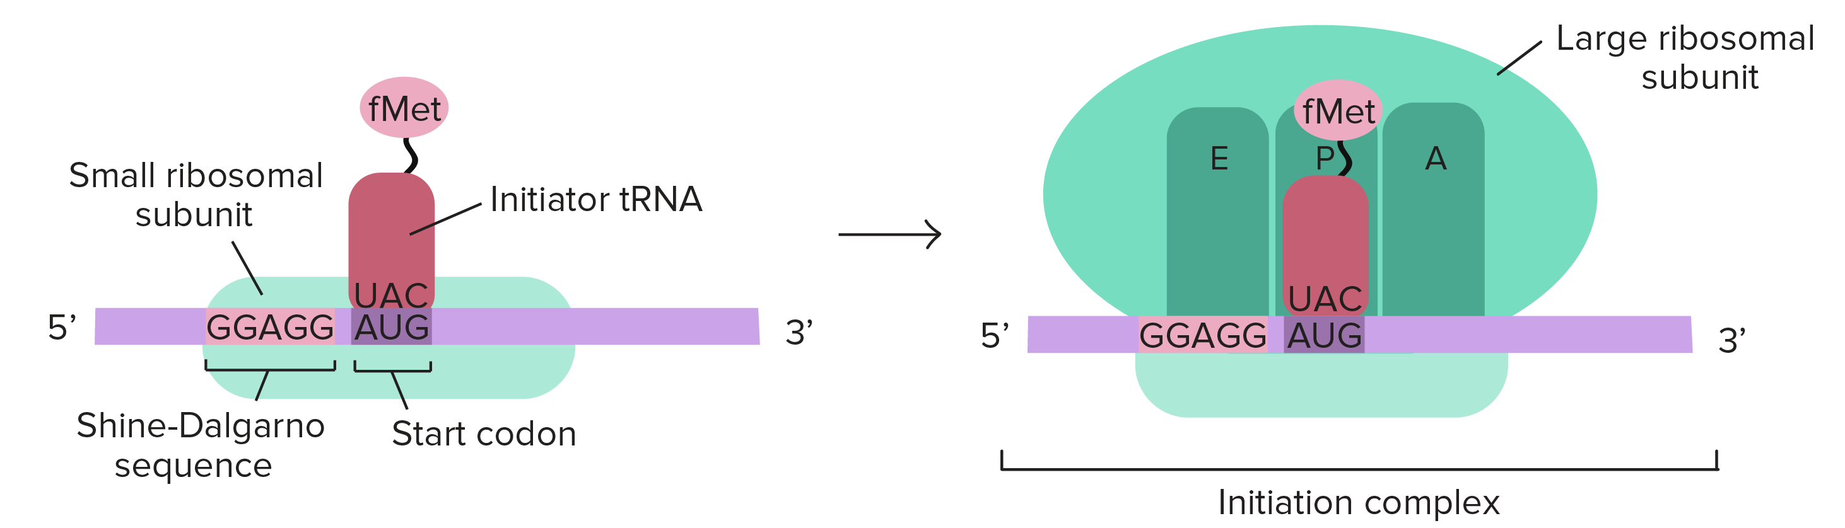
Initiation

Slide 22
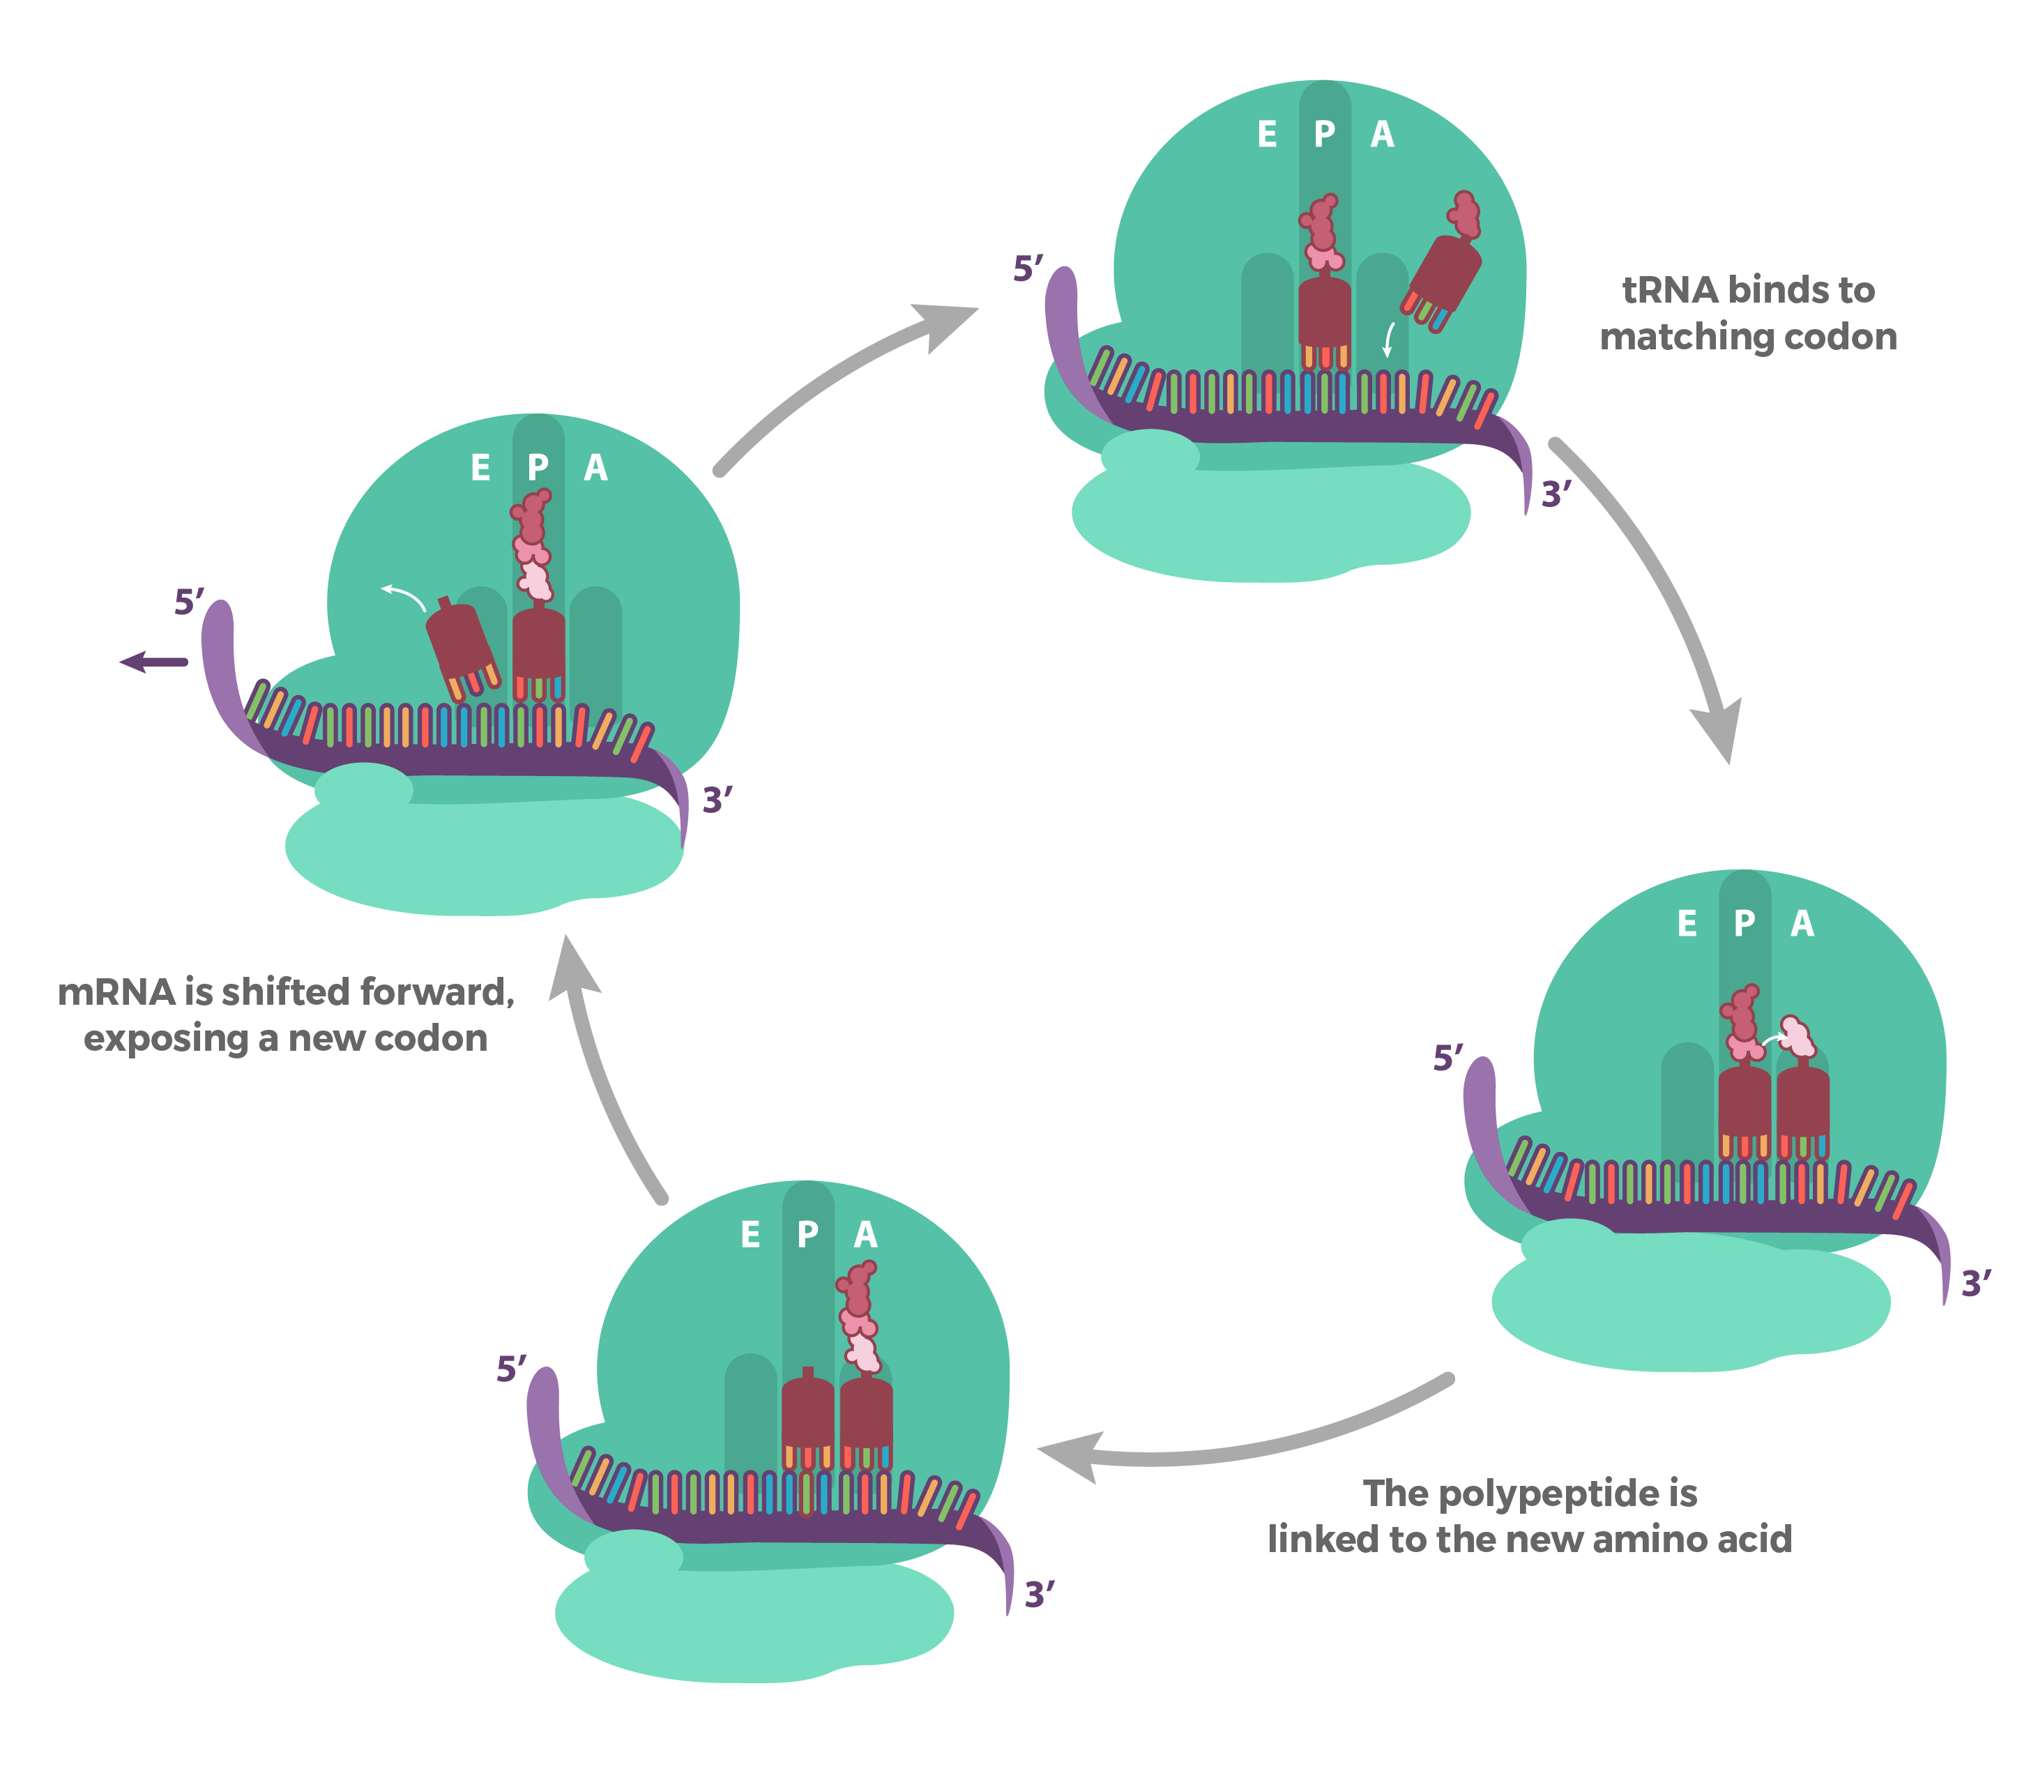
Elongation

Slide 23
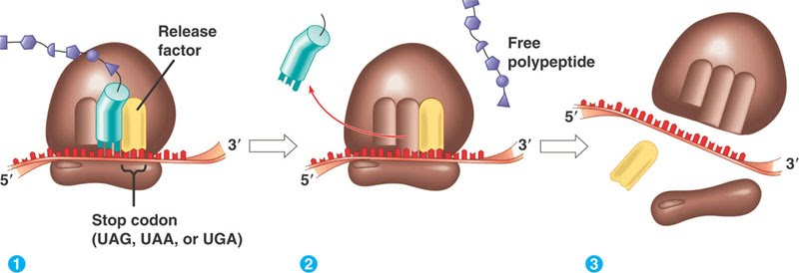
Termination

Slide 24
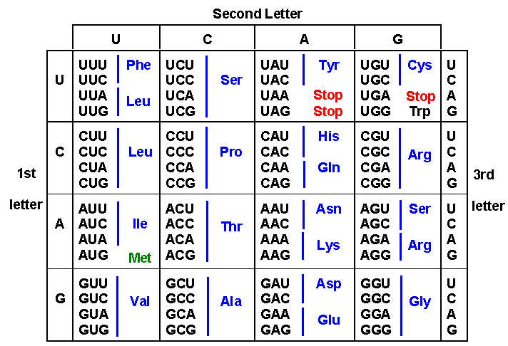
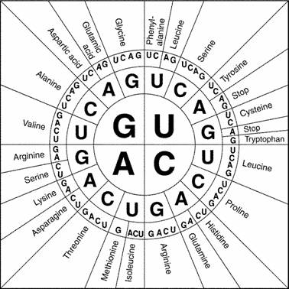
Translation example
UCCAUGAACGACUAAACG
___________/___________/___________/____________

Slide 25
Translation example
UCC AUG AAC GAC UAA ACG
___________/___________/___________/____________

Slide 26
Translation example
UCC AUG AAC GAC UAA ACG
___________/___________/___________/____________
Methionine
Asparagine
Aspartic Acid
Stop

Slide 27
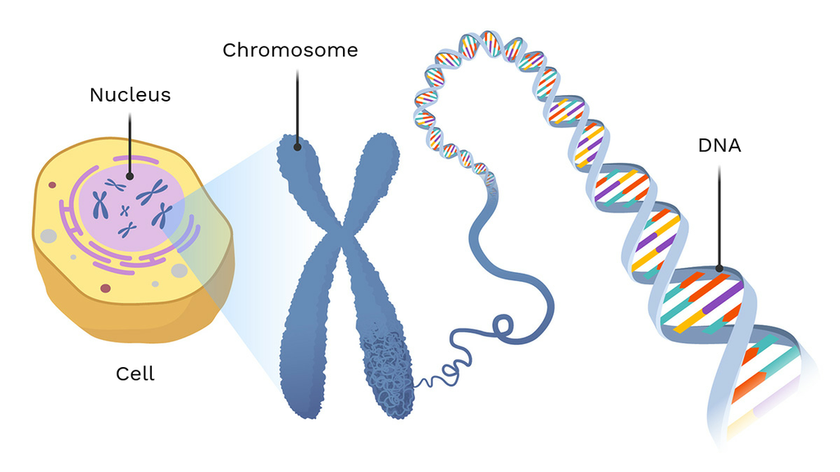
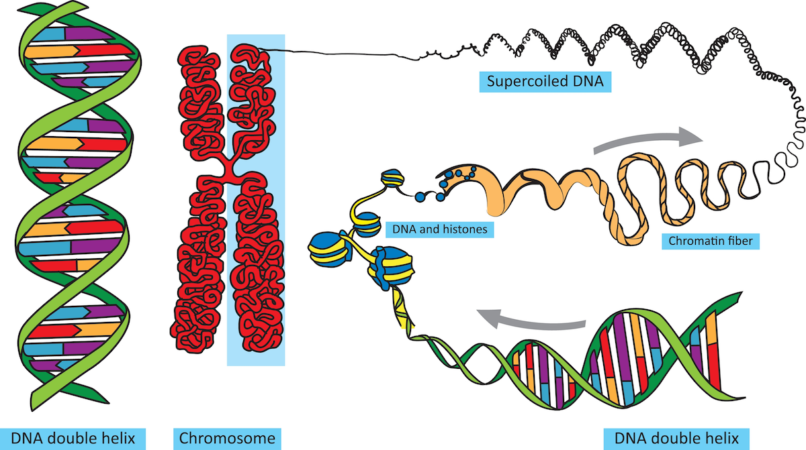
DNA isolation/purification/extraction

Slide 28
DNA isolation methods
Manual
Phenol chloroform
Automated
Machines
Spin column
Magnetic beads

Slide 29
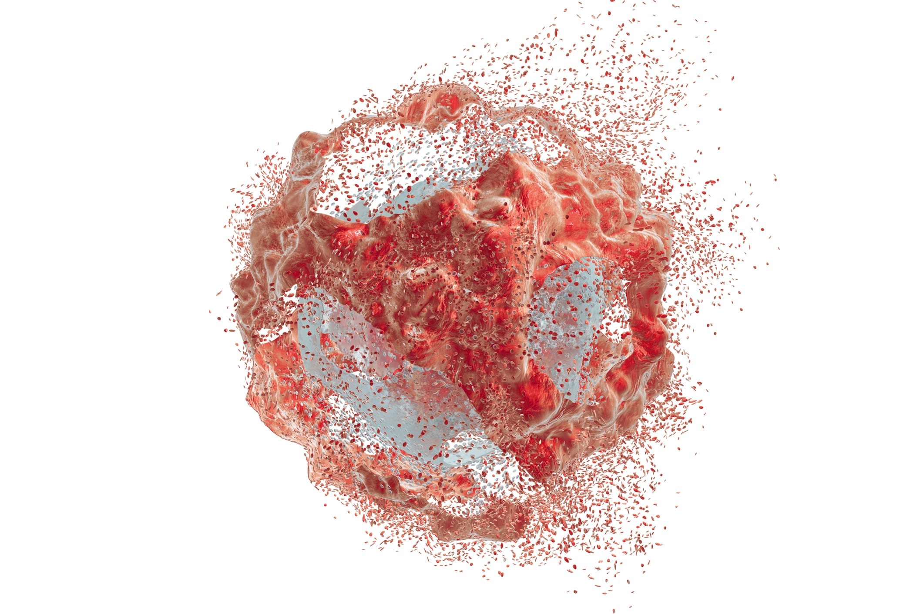
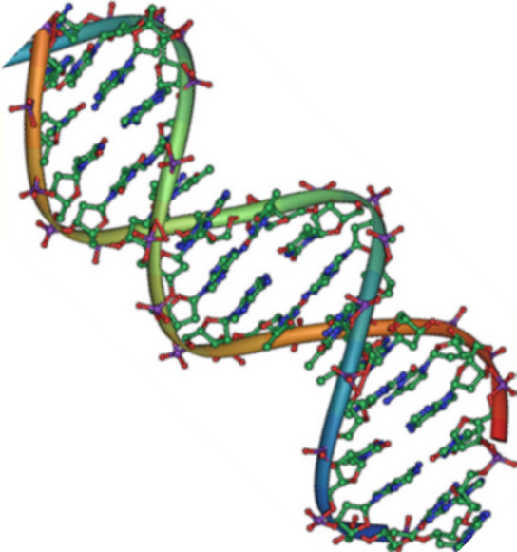
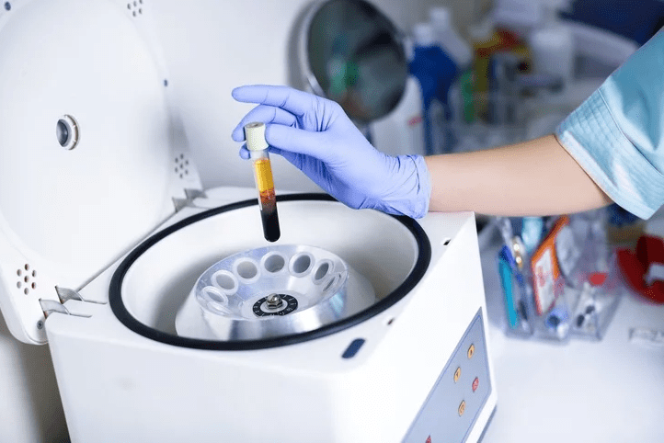
Three major steps
Lysis
Washing-Protein and derbies removal
Collection of purified DNA

Slide 30
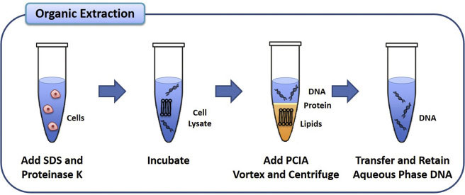
Phenol-Chloroform gDNA extraction

Slide 31
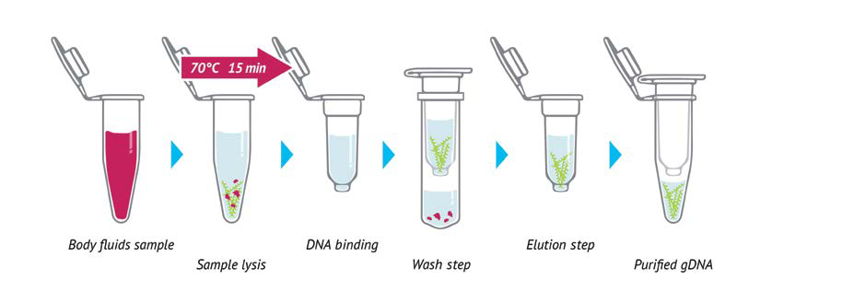
Spin column gDNA extraction

Slide 32
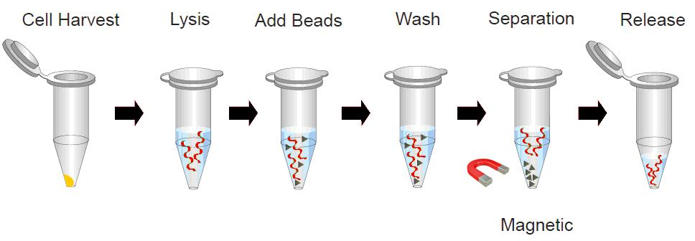
Magnetic bead gDNA extraction

Slide 33
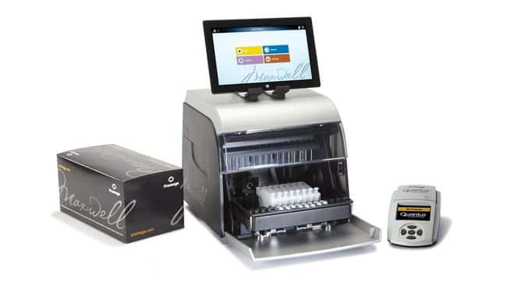
Promega Maxwell™ RSC Cell DNA Purification Kit

Slide 34
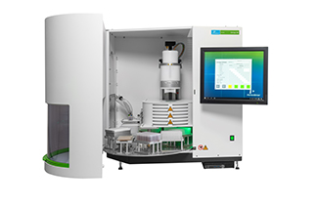
The chemagic™ 360 instrument: a compact solution for automated DNA and RNA purification

Slide 35
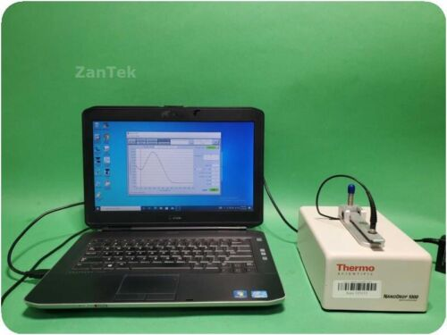
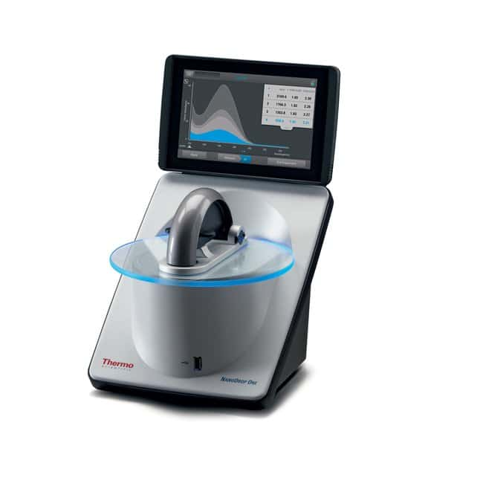
DNA quantification

Slide 36
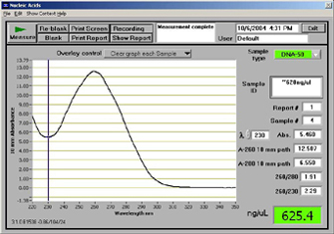
DNA quality check

Slide 37
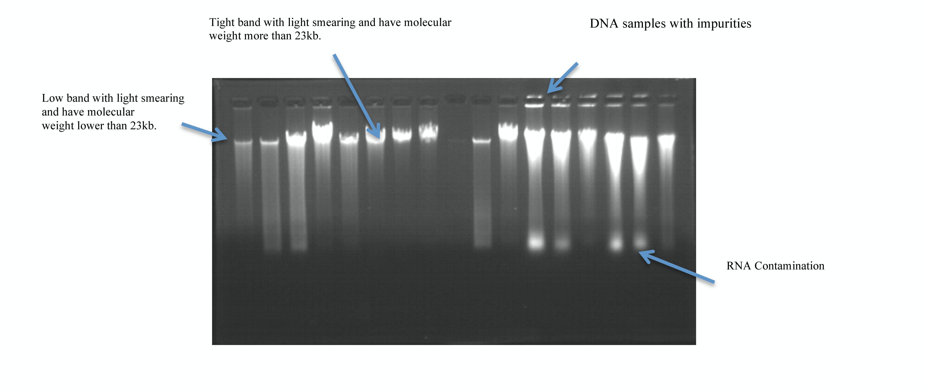
gDNA integrity gel

Slide 38


Slide 39
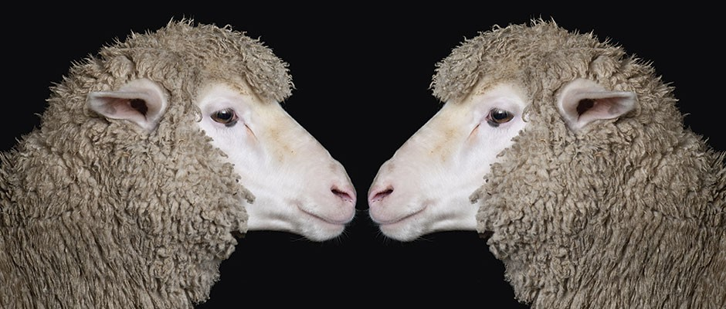
Gene cloning
Genetically identical organisms or molecules derived from a common ancestor

Slide 40
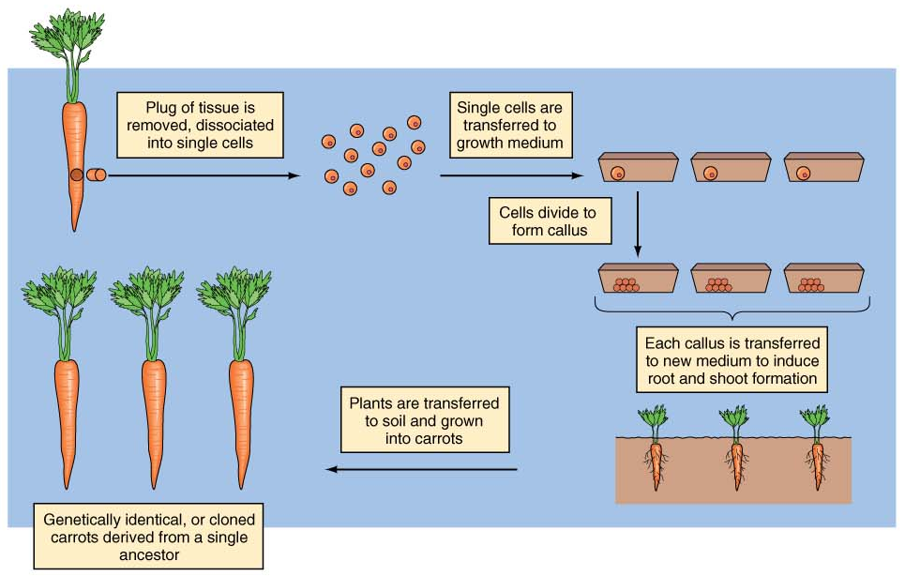
Cloning Plants from Single Cells
Fig. 13.1

Slide 41
Cloning Animals
Animals were cloned more than 20 years ago
Two techniques
Embryo splitting
Nuclear transfer

Slide 42
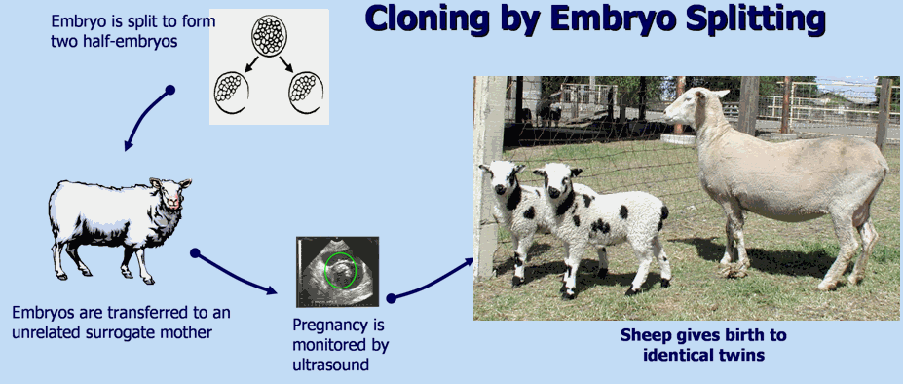
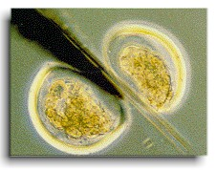
Egg collected
Fertilized by in vitro fertilization (IVF)
Embryo is grown to 8–16 cells
Cells are separated
Separated cells grown into separate embryos
Embryos transplanted into surrogate mothers
May be used to clone any mammalian embryos, including humans
animalscience.ucdavis.edu
library.thinkquest.org

Slide 43
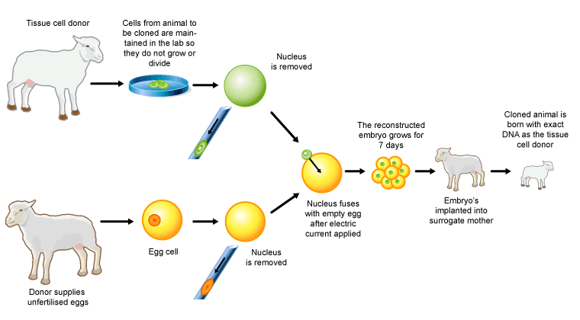
Cloning by nuclear transfer
www.biotechnologyonline.gov.au

Slide 44
Nuclear Transfer
First done in 1986
More difficult
Nucleus is removed from an egg
Enucleated eggs are fused with other cells
Embryos are transplanted into a surrogate mother
In 1997, Dolly the sheep was the first mammalian clone from an adult donor cell

Slide 45
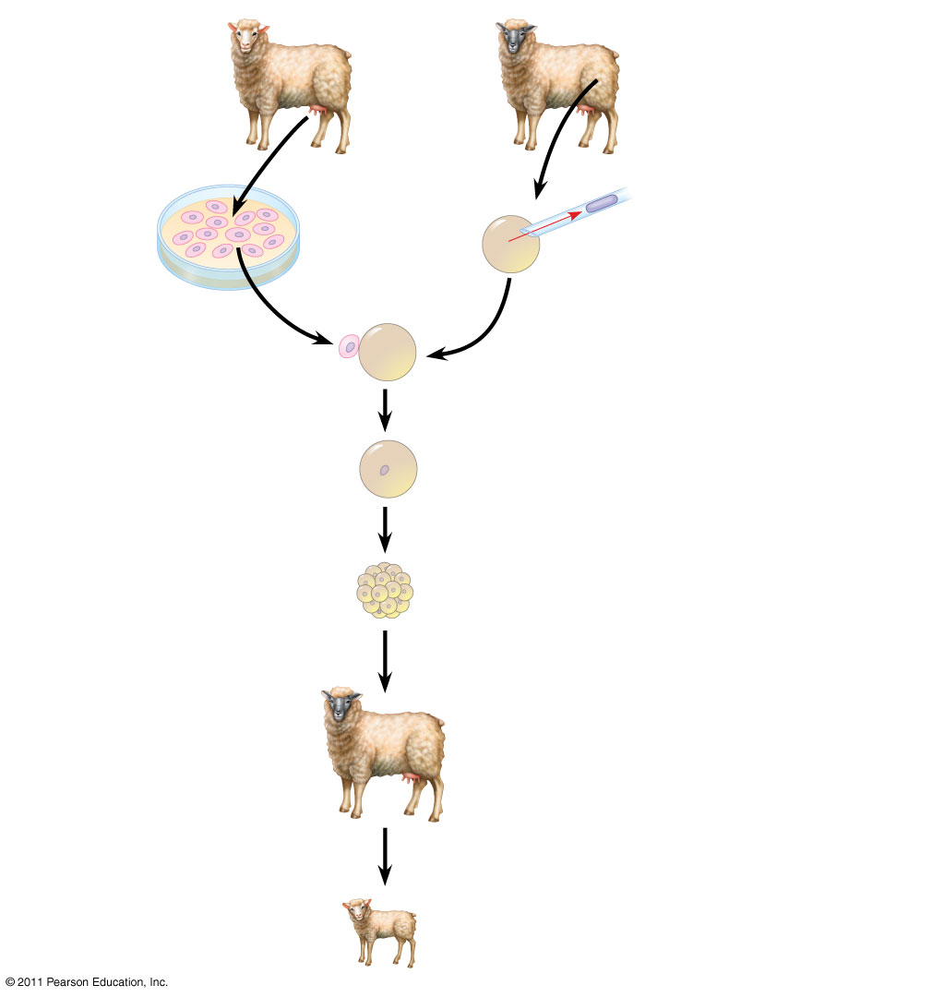
TECHNIQUE
Mammary cell donor
Egg cell donor
1
Egg cell from ovary
2
Nucleus removed
3
Cells fused
Cultured mammary cells
Nucleus from mammary cell
4
Grown in culture
Early embryo
5
Implanted in uterus of a third sheep
Surrogate mother
6
Embryonic development
RESULTS
Lamb (“Dolly”) genetically identical to mammary cell donor
Notes:
Figure 20.19 Research Method: Reproductive Cloning of a Mammal by Nuclear Transplantation

Slide 46
Problems -
don’t live as long
not carbon copies/identical
develop diseases early
very low success rate - 0.1 - 3%
Dedifferentiation/reprogramming may not be complete
or accurate

Slide 47
Gene Cloning
GOAL: To get enough copies of the gene to manipulate
Gene
Cloning vector
Recombinant DNA
Host
Multiply
Started with: few copies
Ended with: Many copies.
All identical to starting gene - CLONES

Slide 48
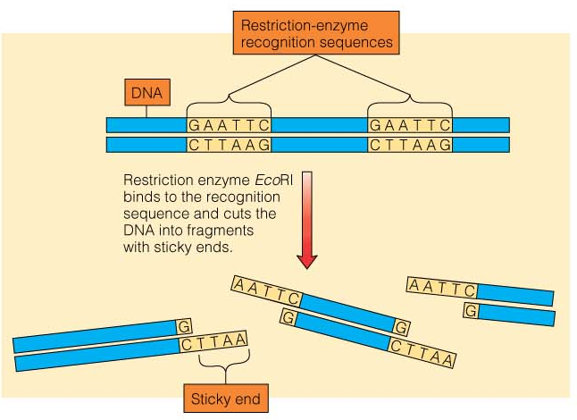
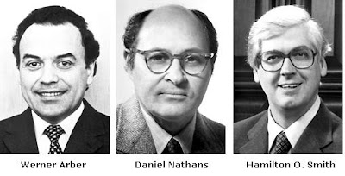
Restriction Enzymes
Nobel Prize
Werner Arber, Daniel Nathans and Hamilton O. Smith, 1978
Fig. 13.6

Slide 49
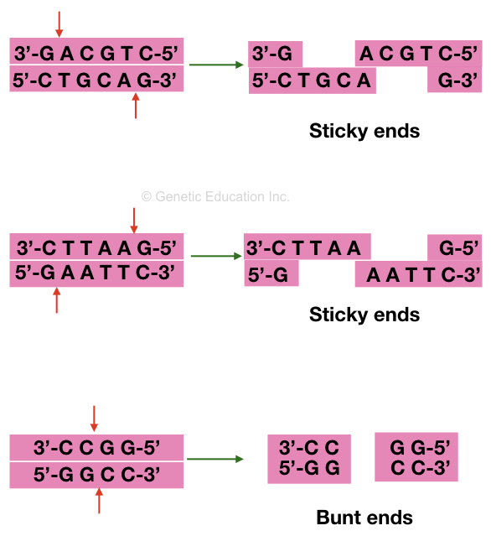
Restriction Enzymes

Slide 50
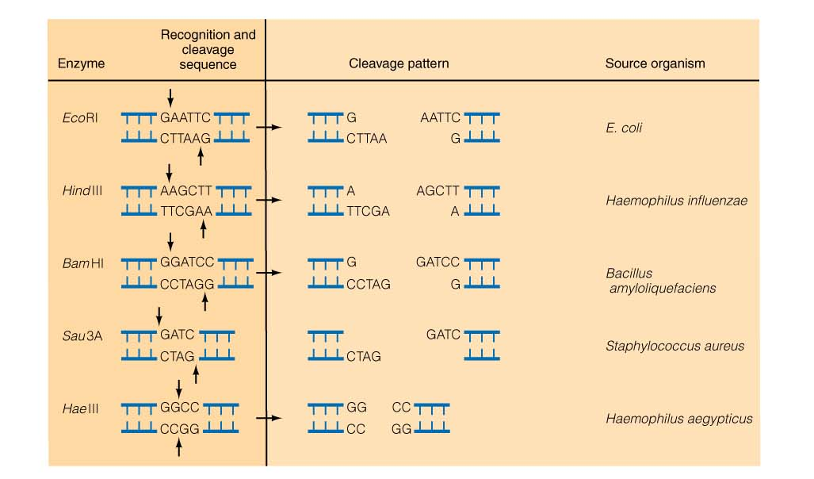
Common Restriction Enzymes
Fig. 13.8

Slide 51
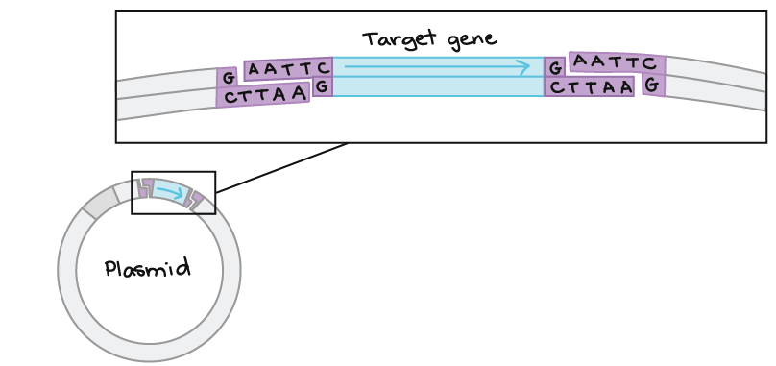
Inserting foreign DNA using restriction enzymes

Slide 52
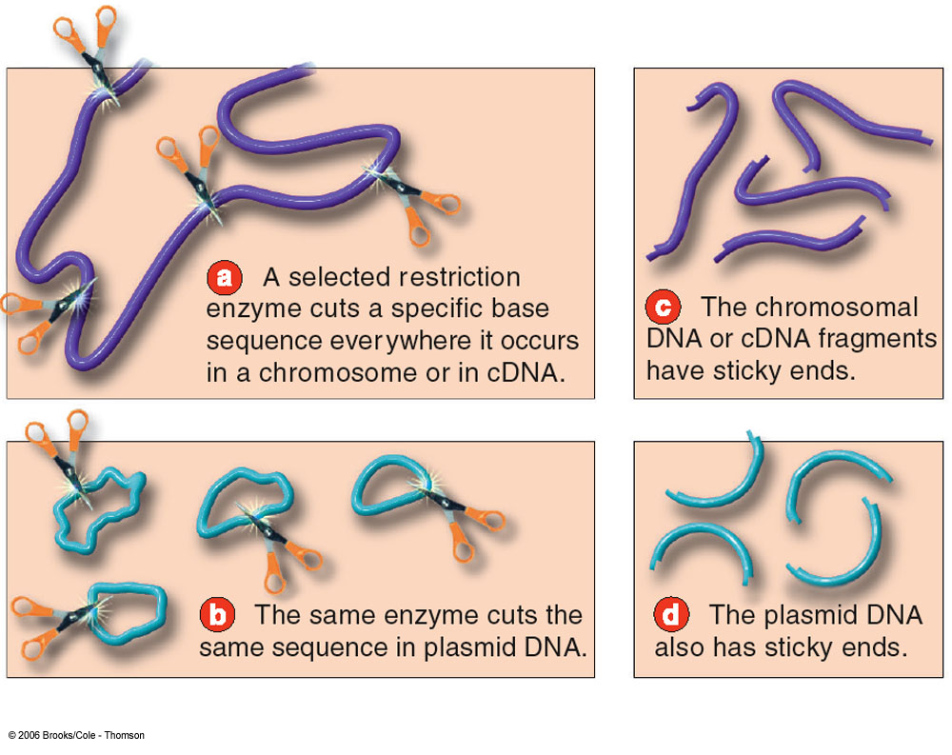
Cloning DNA in Plasmid Vectors
Fig. 13.11a-d

Slide 53
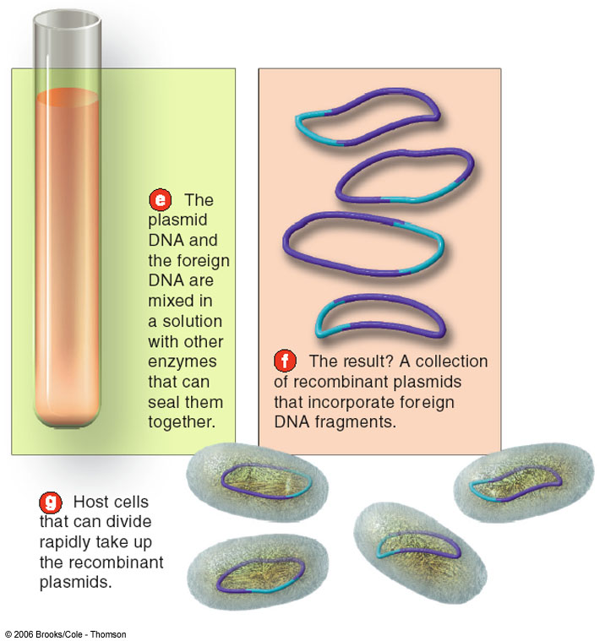
Fig. 13.11e-g

Slide 54
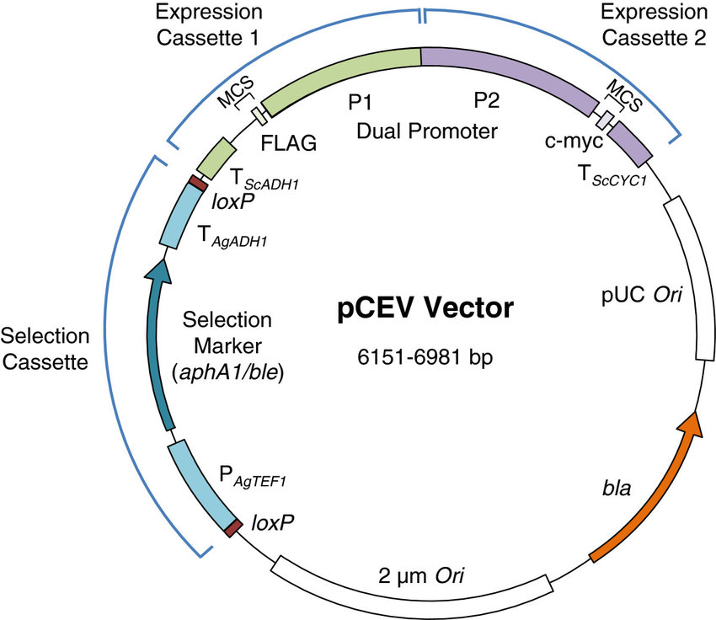
Plasmid plan

Slide 55
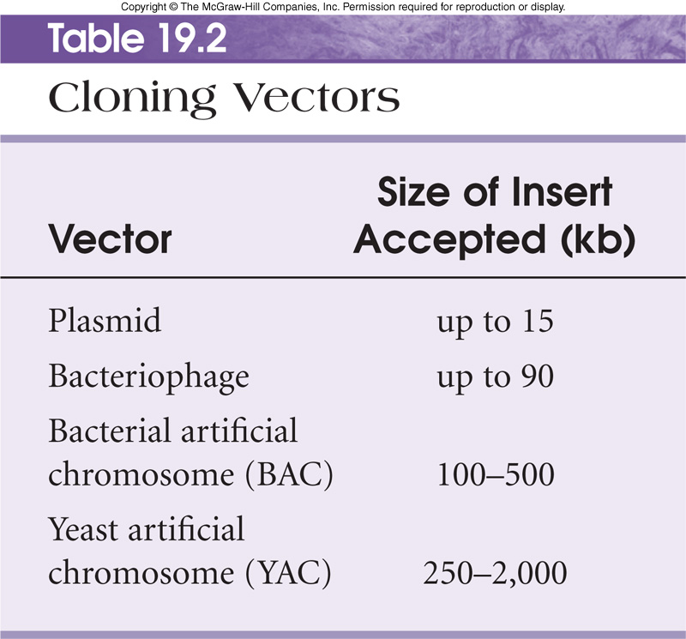
Table 19.2

Slide 56
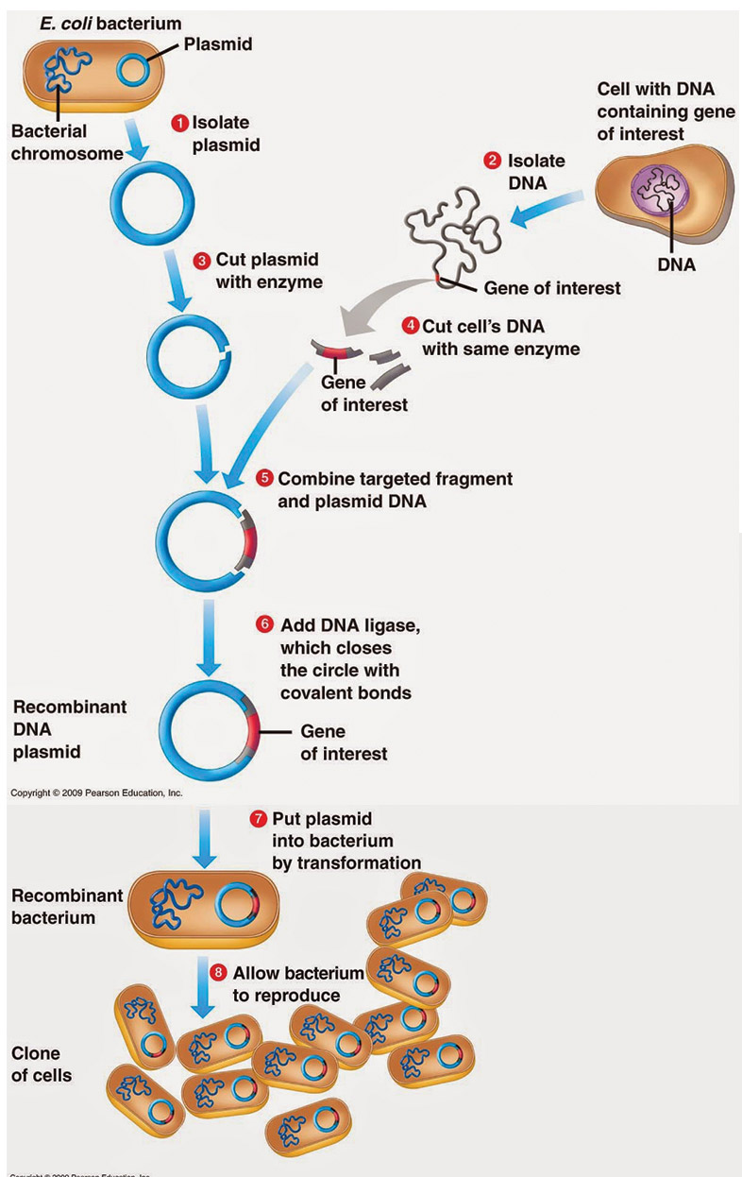
Steps in cloning a single piece of DNA
1. Appropriate restriction sites
2. Cut vector and foreign DNA with RE
3. Run on gel to separate fragments
4. Isolate specific fragment
5. Ligate with cut vector
6. Transform host bacteria. Selection.
7. Grow up colonies.
8. Isolate plasmid DNA.
9. Cut with RE to confirm presence of foreign DNA.
10. Run on gel to identify recombinant plasmids.

Slide 57







Polymerase chain reaction (PCR)
Source ppt..Polymerase Chain Reaction (PCR)
https://www.alrasheedcol.edu.iq
BCH361- Practical

Slide 58






Slide 59


In a crime scene, a sample of DNA was found, however amount of DNA was not enough to
be analyzed.
After DNA extraction, the scientist want to study a specific part of a gene to do sequencing.
How scientist solve these problem ?

Slide 60


The solution is to do amplification of parts of DNA!!
Mainly there are two methods:
Amplifying segment of
DNA
Polymerase chain reaction
Cloning

Slide 61










PCR is a means to amplify a particular piece of DNA .
Amplify= making numerous copies of a segment of DNA.
PCR can make billions of copies of a target sequence of DNA in short time.
It is a laboratory version of DNA Replication in cells.
The laboratory version is commonly called “in vitro” since it occurs in a test tube while “in vivo” signifies occurring in a living cell.

Slide 62
So…
How the amplification will be done?
How you will determine your target sequence?
How the amplification will be specific for certain segment?
You must to understand these questions

Slide 63



PCR does not copy all of the DNA in the sample. It copies only a very specific sequence of genetic code from a template DNA, targeted by PCR primers.
It does require the knowledge of some DNA sequence information which flanks the fragment of DNA to be amplified (target DNA).
Primer
Primer

Slide 64


From this information two synthetic oligonucleotide primers may be chemically synthesised each complementary to a stretch of DNA to the 3’ side of the target DNA, one oligonucleotide for each of the two DNA strands (DNA polymerase can add a nucleotide only onto a preexisting 3'-OH group).

Slide 65

Forward strand
In a PCR reaction you need two primers to amplify the target sequence:
One called: Forward primer, which have the same sequence of forward DNA strand and bind to the complementary reverse strand.
The second called: Reverse primer, which have the same sequence of reverse DNA strand and bind to the complementary forward strand.
Reverse strand
*If there is only one primer, only one strand of the double stranded DNA will be amplified in the PCR reaction.

Slide 66



MgCl₂
Additional reagents may included

Slide 67







PCR proceeds in THREE distinct steps Governed by Temperature:
The double-stranded template DNA is
denatured by heating, typically to 95°C, to separate the double stranded DNA.
The reaction is rapidly cooled to an annealing temperature to allow
the oligonucleotide
primers to hybridize to the template.
The reaction is heated to a temperature, typically 72°C for
efficient DNA synthesis
by the thermostable DNA polymerase.
Denaturation:
(95⁰C)
**Annealing:
(50-65⁰C)
Extension:
(72⁰C)

Slide 68





The double-stranded template DNA is denatured by heating, typically to 95°C, to separate the double stranded DNA (why?).
Breaking the bonds.
Step 1
(94–97 °C )

Slide 69


The reaction is rapidly cooled to the primer annealing temperature (50-65 °C) to allow the oligonucleotide primers to hybridize to single stranded template.
Primer will anneal only to sequences that are complementary to them (target sequence).
What is the type of the bond?
Step 2
(50–65 °C )

Slide 70



The reaction is heated to a temperature depends on the DNA polymerase used.
Commonly a temperature of 72°C is used with this enzyme.
This means that 72°C is the optimum ………………… of DNA polymerase.
At this step the DNA polymerase synthesizes a new DNA strand complementary to the DNA template
Step 3
(72 °C )

Slide 71

One _{X 25}
cycle

Slide 72

At the end of the PCR reaction, the specific sequence will be accumulated in billions of copies (amplicons).
In only 20 cycles, PCR can product about a million (2²⁰) copies of the target.

Slide 73




Marker
Target sequence

Slide 74







Simplicity, easier methodology, sensitive, extensively validated standard operating procedure and availability of reagents and equipment
Genotyping.
RT-PCR.
Cloning.
Mutation detection.
Sequencing.
Microarrays.
Forensics.
Paternity testing.

Slide 75




Primer sequence
Primer length GC%
GC clamp
Melting temperature (Tm) Annealing temperature (Ta)

Slide 76
1. Primer sequence:
Must be complementary to flanking sequences of target region.
Avoid:
Complementary sequences between primers.
Repeat (ex: ATATATAT) ➔ misprime.
Runs (ex: AGCGGGGGAT) ➔ misprime.
Mismatch at 3’ end.
Cross Homology.
Primer length:
It is generally accepted that the optimal length of primers is 18-25 bp.
Not too long nor too short

Slide 77
3. GC content:
GC% = Number of G's and C's in the primer as a percentage of the total bases.
Should be 40-60%.
GC clamp:
Presence of G or C bases within the last five bases from the 3' end of primers.
Not more than 2 G's or C's .

Slide 78




5. Melting temperature (Tm):
What is Tm?
Melting temperatures in the range of 50-60 °C generally produce the best results.
Maximum difference between primer pairs is 5°C.
The Tm of the primer can be calculated by the following formula:
Tm = [(G + C) x 4] + [(A + T) x 2]
Annealing Temperature (Ta):
The primer melting temperature is the estimate of the DNA-DNA hybrid stability and critical in determining the annealing temperature.
Depends directly on length and GC composition of the primers.
Too high Ta ➔ produce insufficient primer-template hybridization.
Too low Ta ➔ lead to non-specific products caused by a high number of base pair mismatches.

Slide 79








How the amplification will be done?
How you will determine your target sequence?
How the amplification will be specific for certain segment?
What are the requirements to carry PCR?

Slide 80






Slide 81

Restriction fragment length polymorphism

Slide 82

Notes:
https://www.google.com/url?sa=i&url=https%3A%2F%2Fwww.youtube.com%2Fwatch%3Fv%3Dn2bVFcJP-HY&psig=AOvVaw1ynY04SEpvCedrTyV77v-B&ust=1674439526762000&source=images&cd=vfe&ved=0CBAQjhxqFwoTCKD4mruL2vwCFQAAAAAdAAAAABAq

Slide 83
Practical exercise 1

